Slide 1
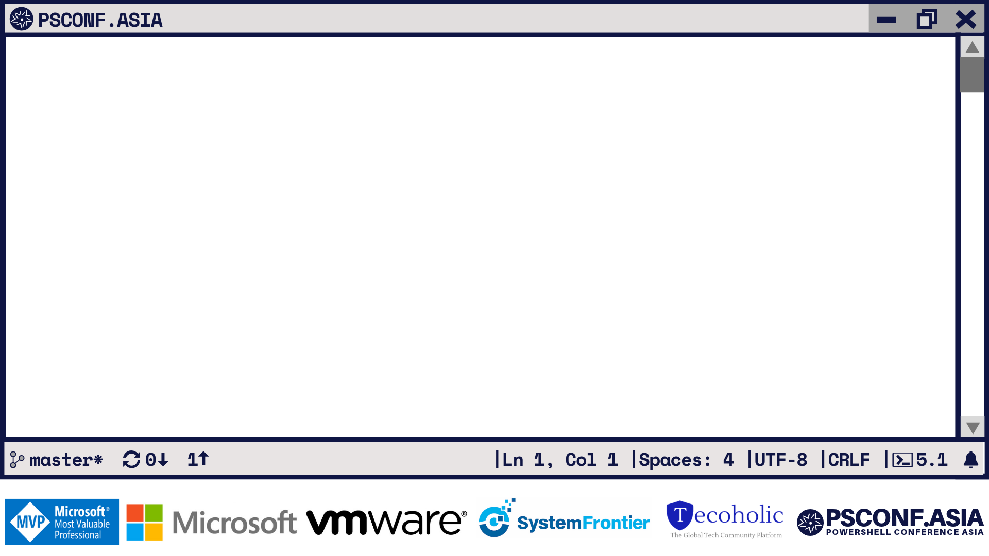
Better Ops Together
Practical PowerShell Pair Programming Patterns and Practices with VS Code
Mark Kraus Staff Systems Engineer, LinkedIn

Slide 2
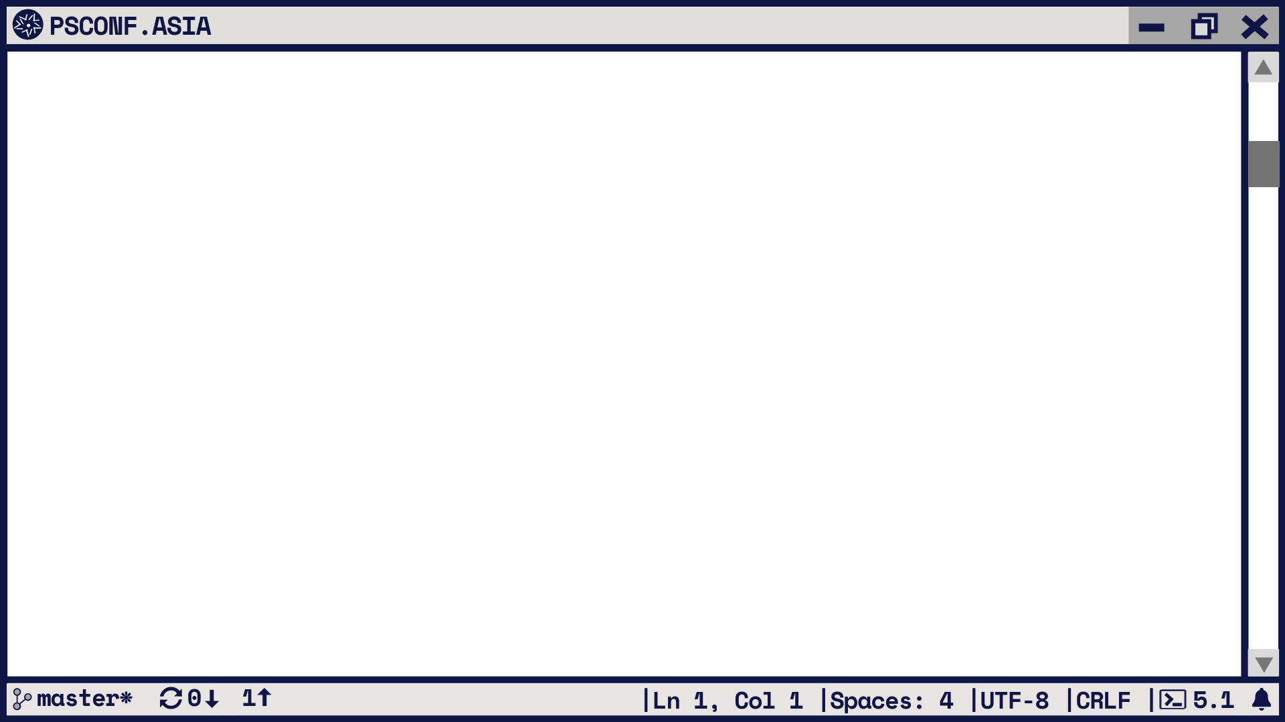

What is Pair Programming?
2 people programming the same code together
Junior “Driver”
Senior “Navigator”
“Driver” codes
“Navigator” reviews code and plans

Slide 3

Why Do Pair Programming?
Pros
Streamlines review process
Helps spread skills and knowledge
“Two heads are better than one”
Team building
Improves code confidence

Slide 4

Why Do Pair Programming?
Cons
Doubles person-hours
People prefer to program alone
Disjointed or incohesive teams

Slide 5

Pair Programming in Ops?
More automation less console/RDP
Improves automation creation
Teach “developer mindset” to the Ops-minded
No “DevOps” required!
Navigators improve their teaching skills
Teach your co-workers PowerShell!

Slide 6
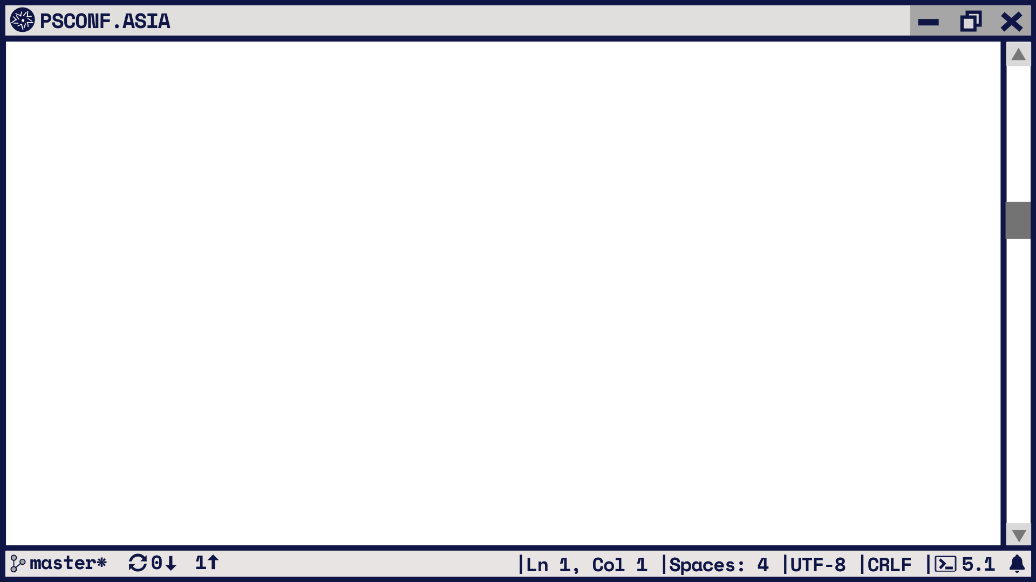

How to Pair Program?
Sit next to one another
Screen sharing & tele-collaboration
Visual Studio and VS Code Live Share
http://aka.ms/LiveShare
Floobits + ( Slack or Discord )
Virtual and Remote Warning:
Navigator stay focused on coder
Close all other screens
Limit distractions
Inform Driver when stepping away

Slide 7

About my Team
IT side (not linkedin.com)
Responsibilities:
Virtual Infrastructure
OS Platform support
Apps/services supporting business
Hybrid On-prem and Azure
Mixed Engineering and Operations
Mixed Remote and On-campus
California and Bengaluru

Slide 8
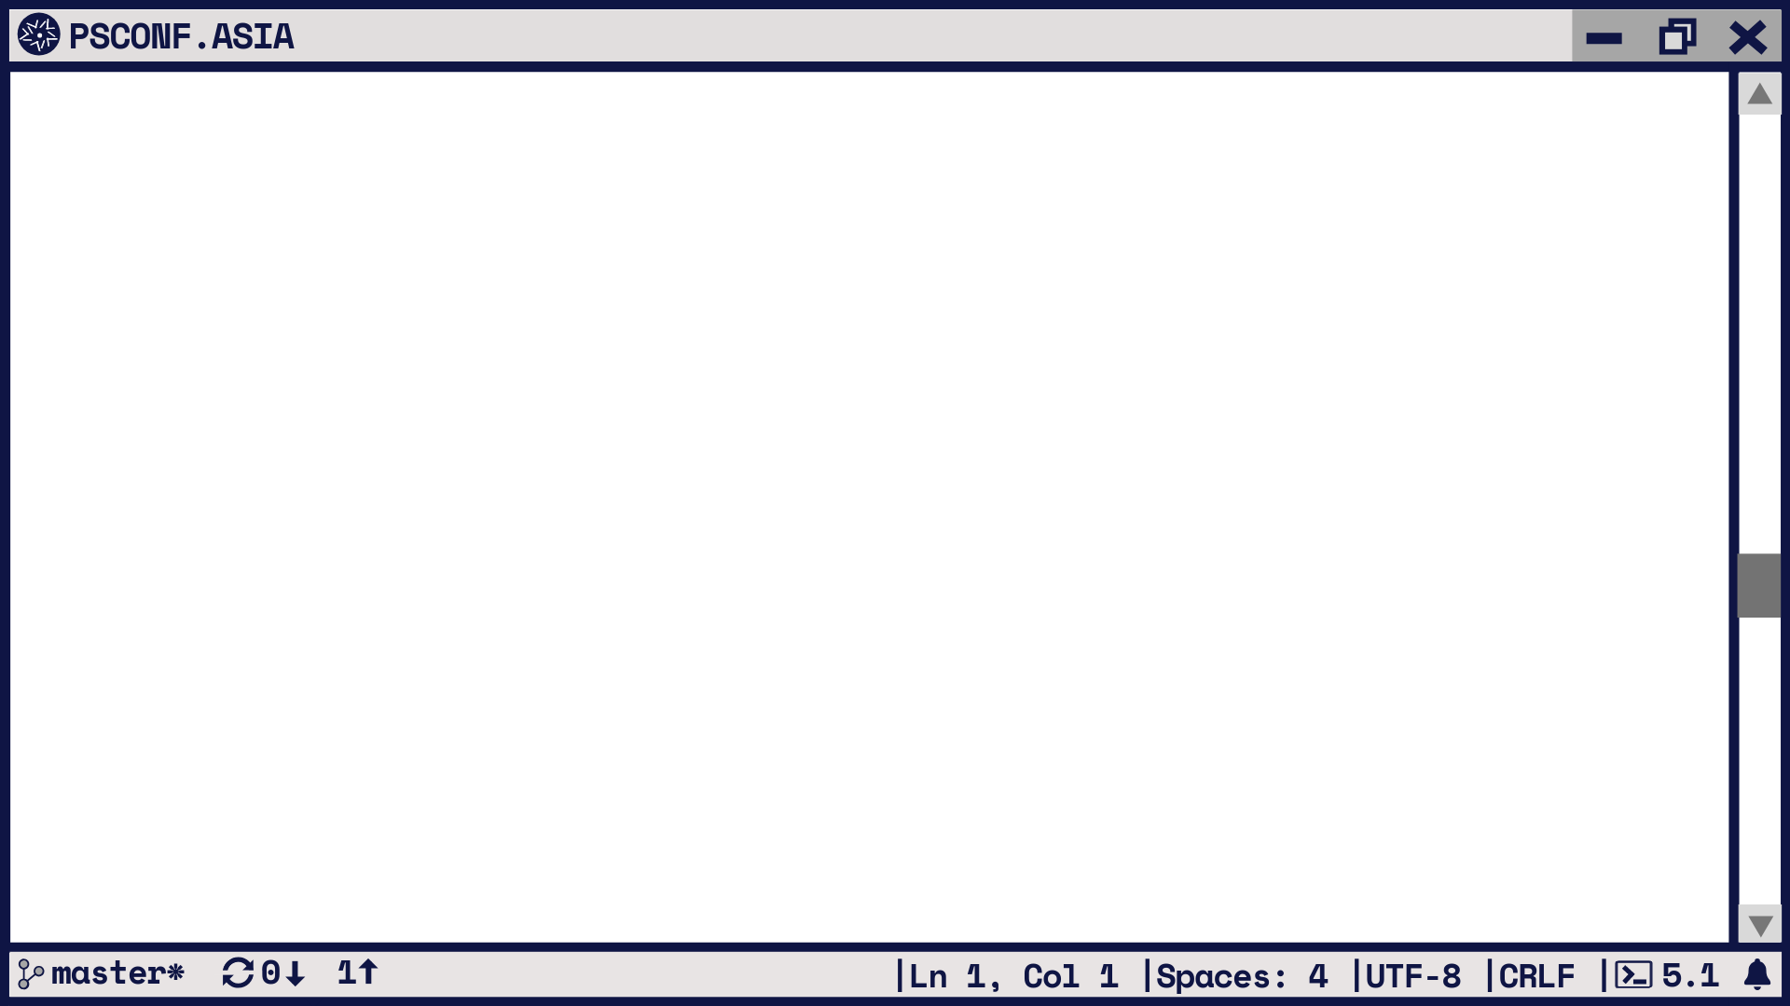

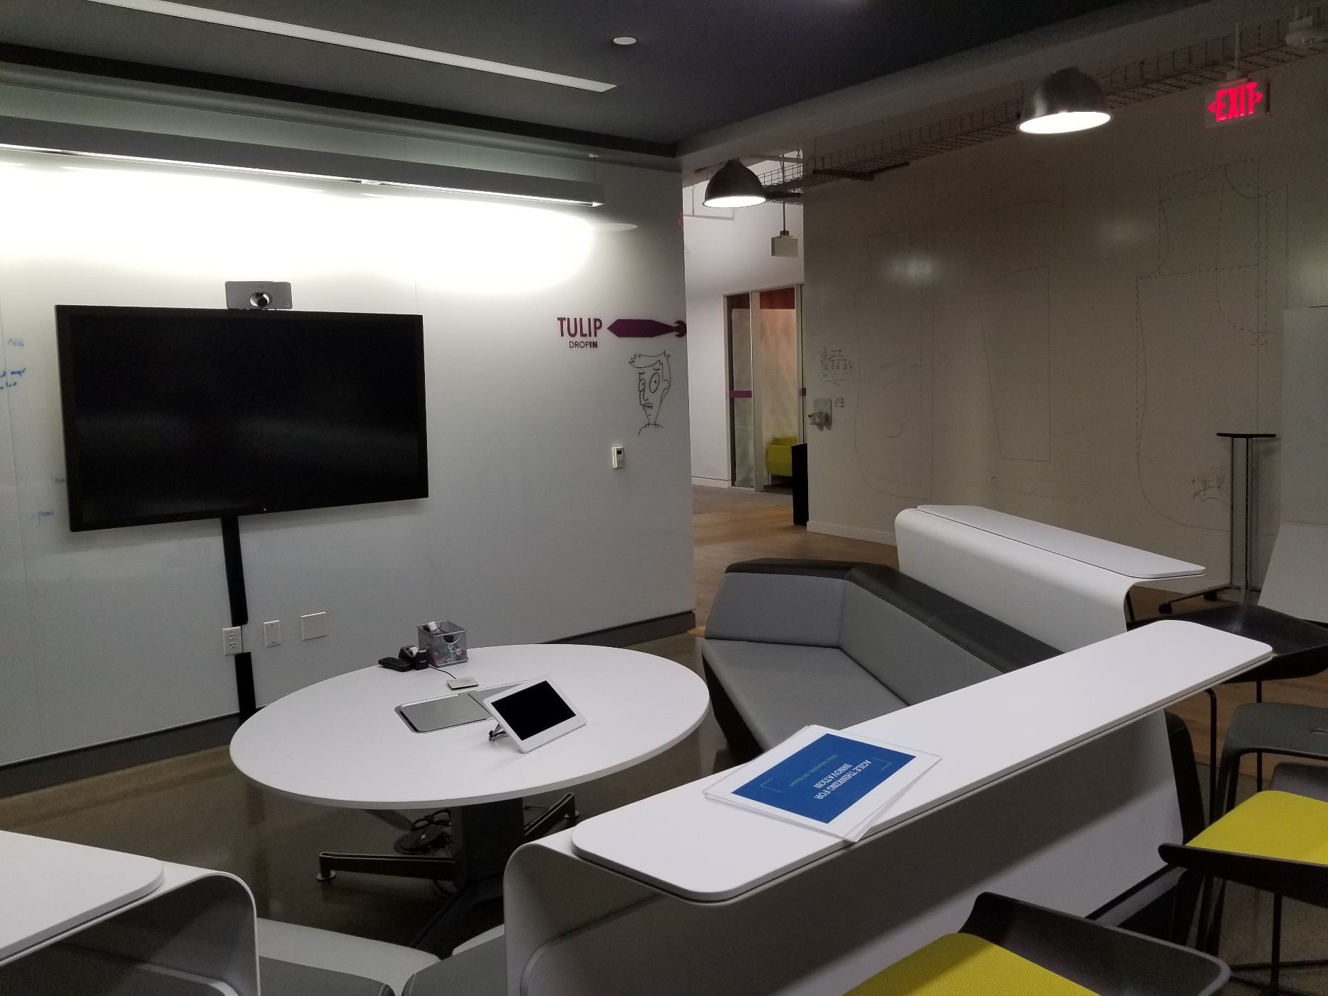
How we Pair Program
“Let’s grab a room and knock this out!”

Slide 9

Our Pair Programming Tech
Teams
VS Code
BlueJeans
Whatever!

Slide 10
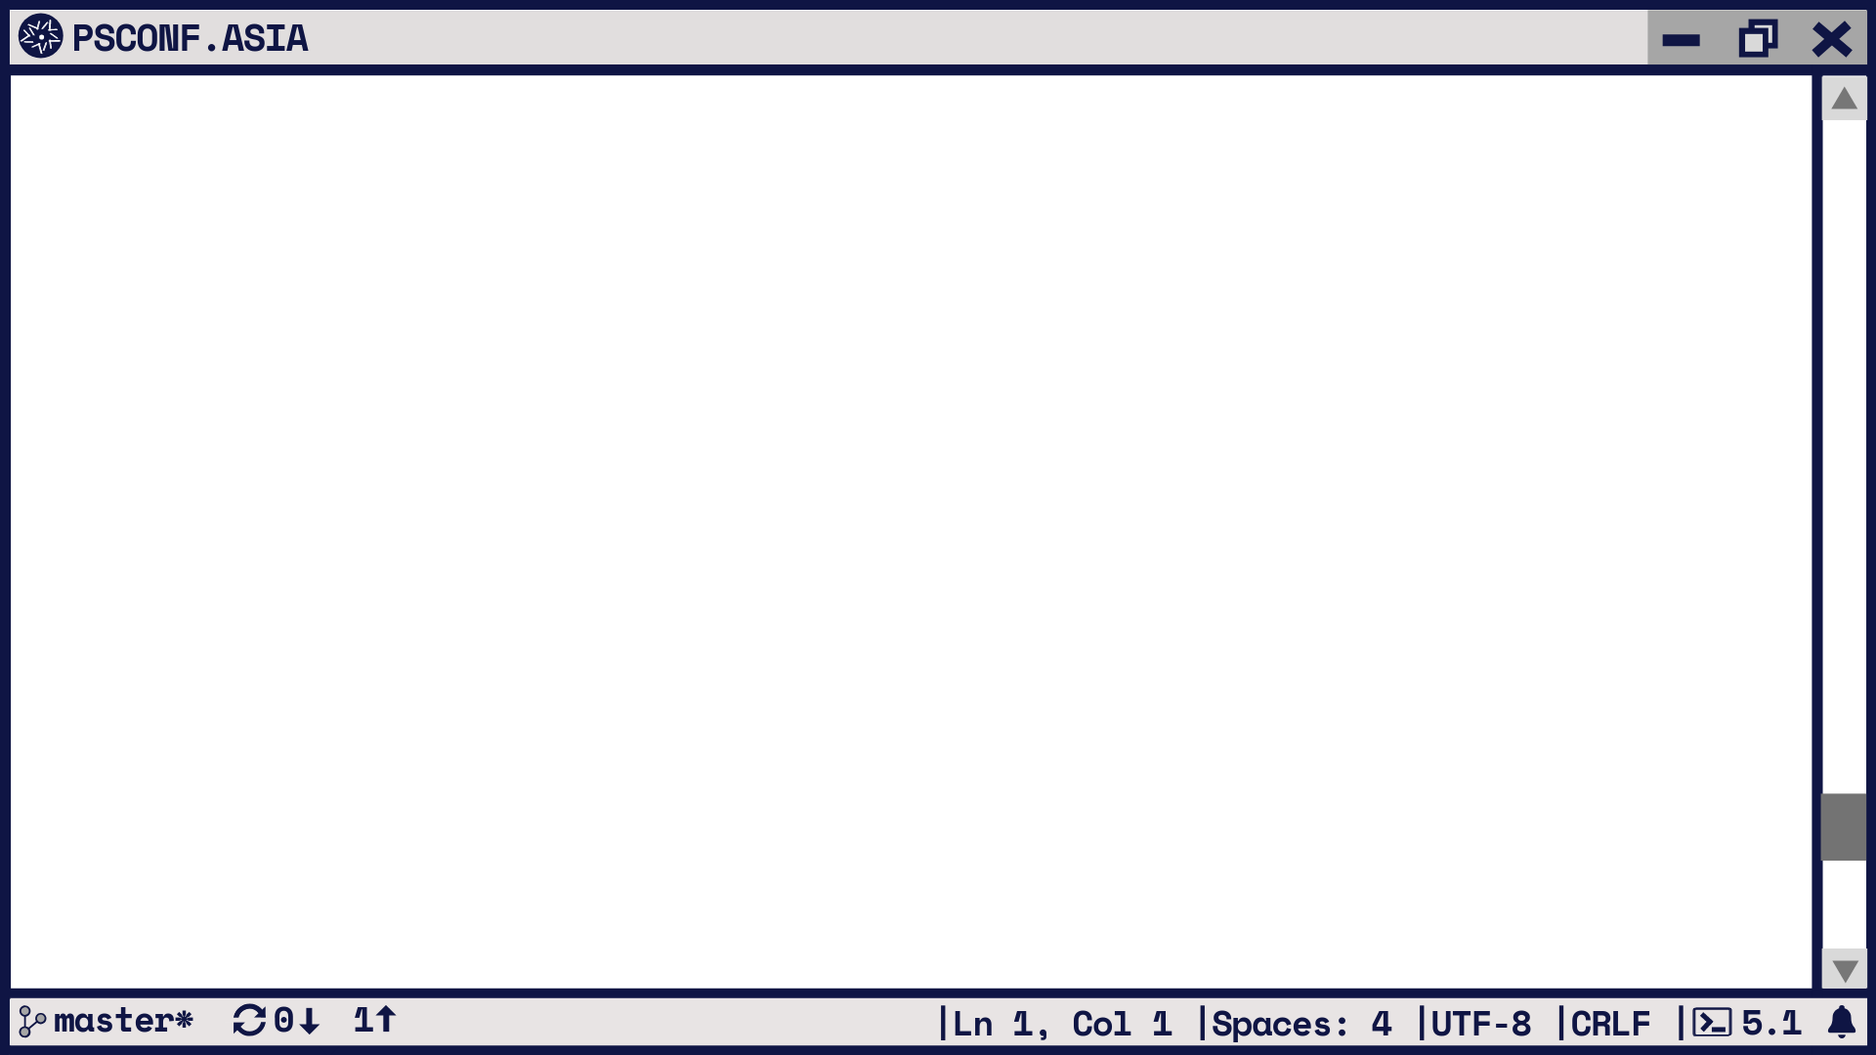
Notes from the Field
Swap between Navigator and Driver
Work separate tickets for the same issue
Show training value to management
Make as much time as possible

Slide 11

Mob Programming
3 or more people programming the same code
Great for complex or cross-discipline issues
One person codes
Others:
Navigate
Whiteboard
Research

Slide 12

Visual Studio Code Live Share Demo

Slide 13
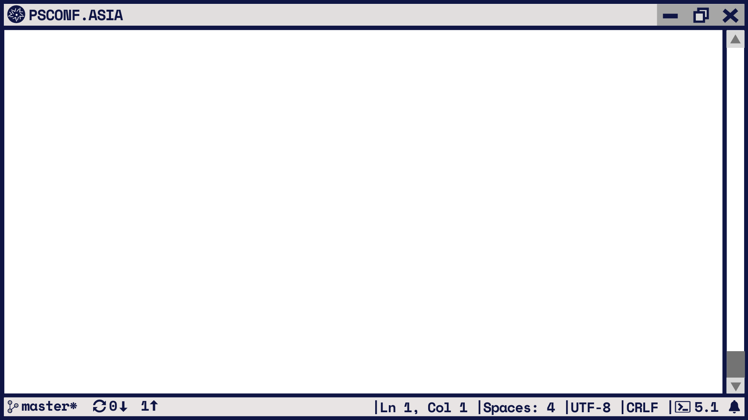
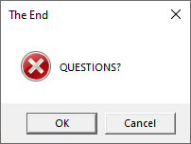

Twitter: @markekraus
GitHub: markekraus
aka.ms/PSDiscord: markekraus
Twitch: markekraus
linkedin.com/in/markekraus/
Get-PowerShellBlog.blogspot.com
Please Rate Sessions on eventRaft

